Slide 1


Data Structure
Dr Shahjad
Faculty
School of Engineering & Technology
K.R. Mangalam University
Unit 4 : Sorting and Searching

Slide 2


Session 36
Divide and Conquer Strategy
Merge Sort
Example of Merge Sort
Algorithm of Merge Sort
Complexity Analysis of Merge Sort
Brainstorming Session

Slide 3
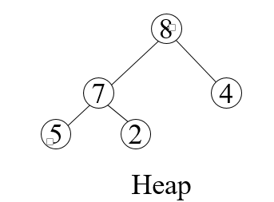
Recap
Heap is a nearly complete binary tree with the following two properties:
Structural property: all levels are full, except
possibly the last one, which is filled from left to right
Order (heap) property: for any node x
Parent(x) ≥ x

Slide 4
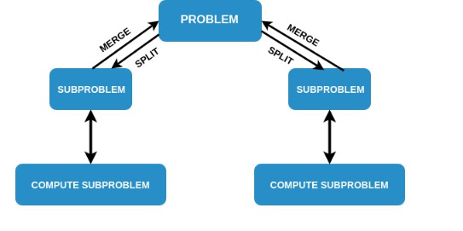
Divide and Conquer Strategy

Slide 5
Concept of Divide and Conquer Algorithm
Divide and conquer is a strategy based on the idea that a given hard problem can be solved by breaking it down into smaller sub problems, which are much easier to solve.
A Divide and Conquer algorithm works by recursively breaking down a problem into two or more sub-problems of similar type, until these become simple enough to be solved directly.
The solutions to the sub-problems are then combined to give a solution to the original problem. A typical Divide and Conquer algorithm solves a problem using following three steps:
Divide : Break the given problem into subproblems of same type.
Conquer : Recursively solve these subproblems.
Combine : Appropriately combine the answers.

Slide 6
Can we perform Sorting using Divide and Conquer?
We can visualise sorting an array of size N as two sub problems : sorting two arrays of size N/2, and then somehow combining the two smaller sorted arrays. Sorting a smaller array will be easier than sorting the bigger array.
Recursive nature of Sorting : Sorting an array of size N can be recursively broken down into sorting two smaller arrays of N/2, and each of these smaller arrays can be broken down into even smaller arrays of size N/4 each, and so on.
Merge sort is a sorting algorithm that uses this approach. In Merge Sort we will:
DIVIDE : Split an array into parts recursively into half.
CONQUER : Sort the sub-arrays individually.
COMBINE : Merge the sorted sub-arrays to get a big sorted array
Unit2

Slide 7
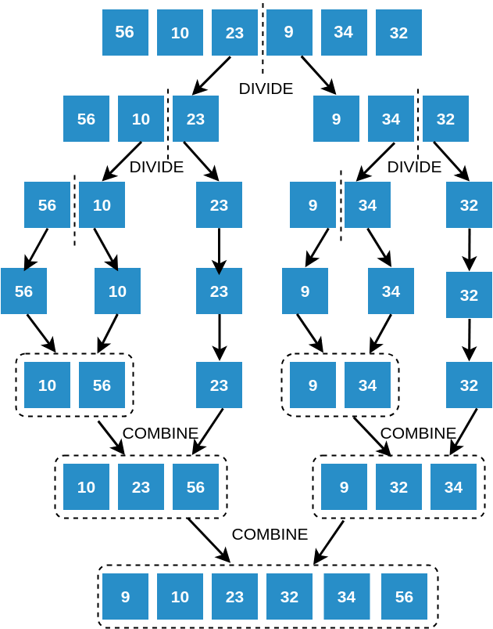
Divide and Conquer in Sorting
Unit2

Slide 8
Merge Sort
The Merge Sort algorithm combines the split and merge step, to give
us a sorted array.
First, we keep splitting the array recursively, till we get all sub arrays
of size 1. Recall how we practiced this in the Split step
Then, once the array cannot be split further, we start tracing back on our Merge Sort tree
As we trace back, we keep merging the child sub arrays and
overwriting the parent sub arrays by their sorted forms
Unit2

Slide 9
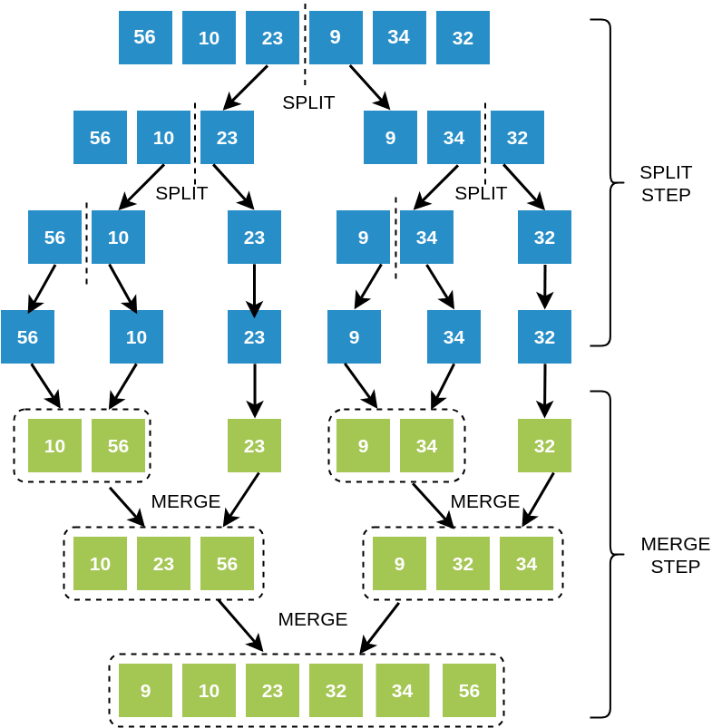
Merge Sort Tree
Unit2

Slide 10

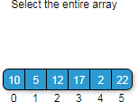
Demo
Unit2

Slide 11
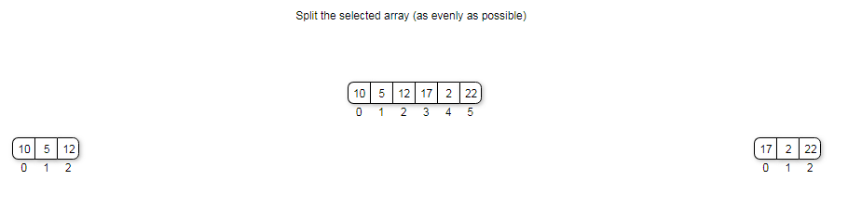
Demo
Unit2

Slide 12
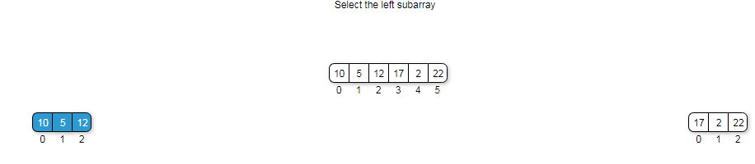
Demo
Unit2

Slide 13
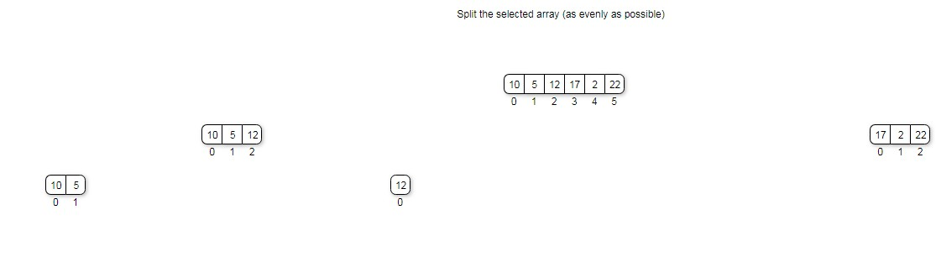
Demo
Unit2

Slide 14
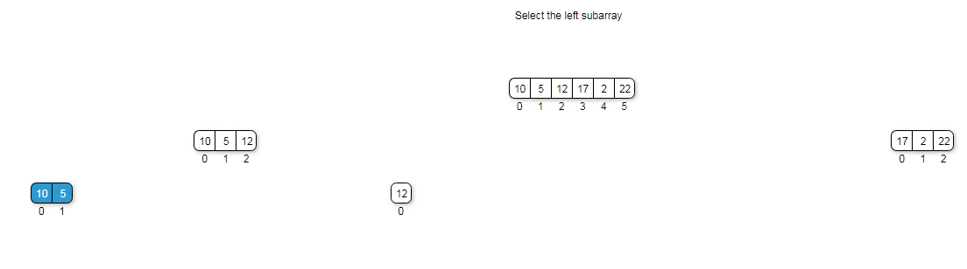
Demo
Unit2

Slide 15
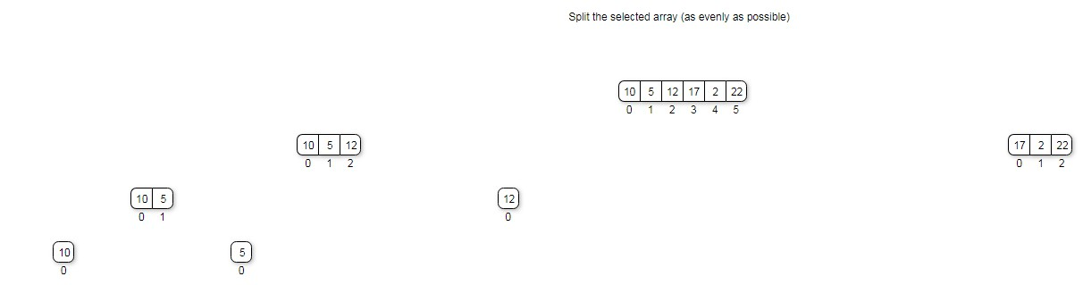
Demo
Unit2

Slide 16
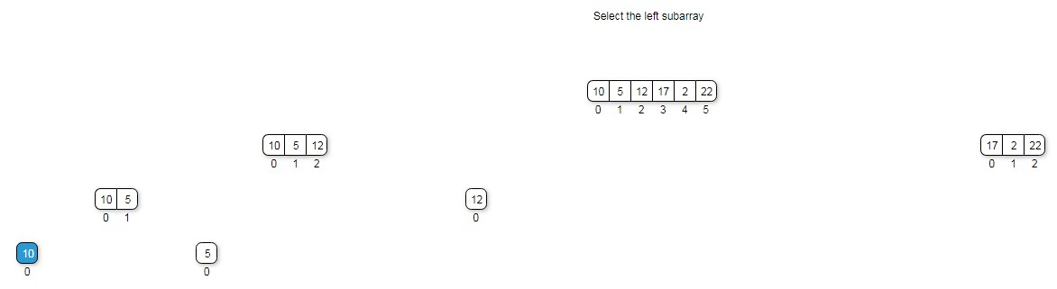
Demo
Unit2

Slide 17
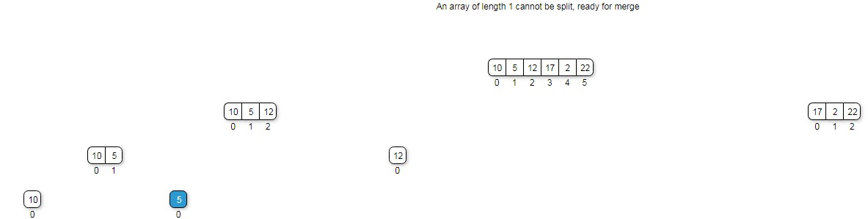
Demo
Unit2

Slide 18
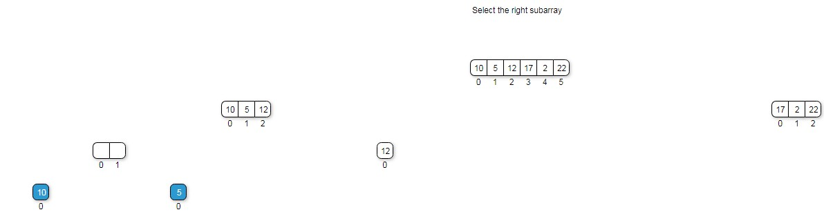
Demo
Unit2

Slide 19
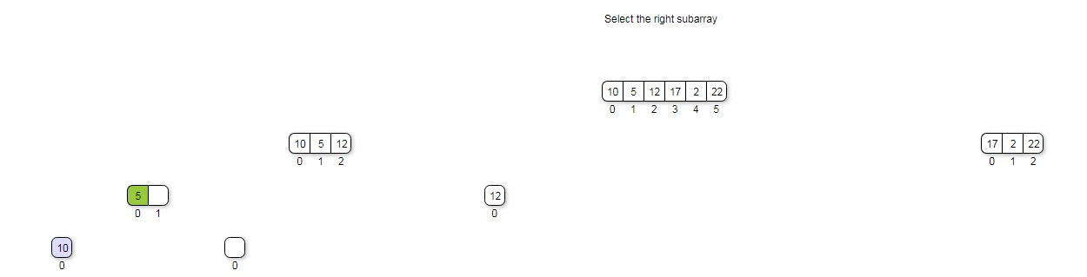
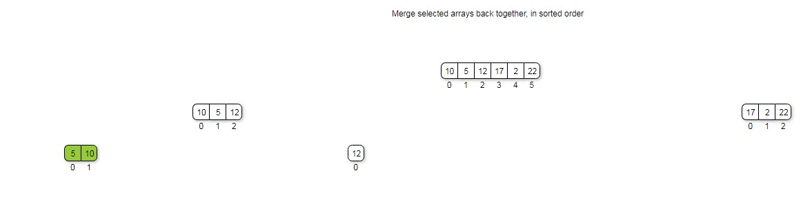
Demo
Unit2

Slide 20
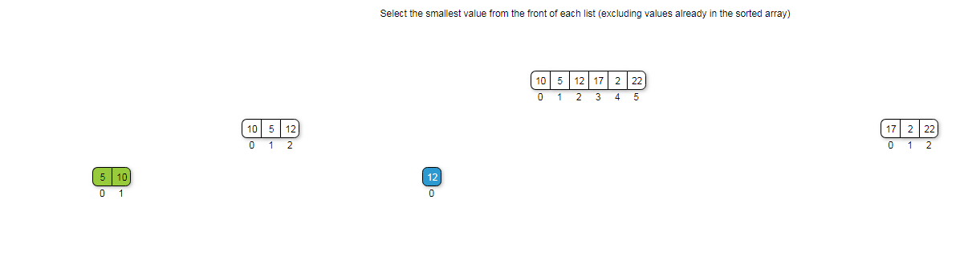
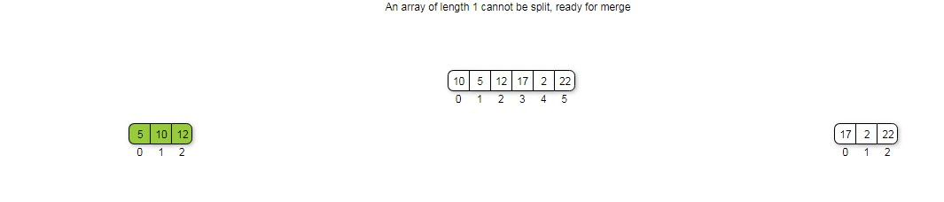
Demo

Slide 21
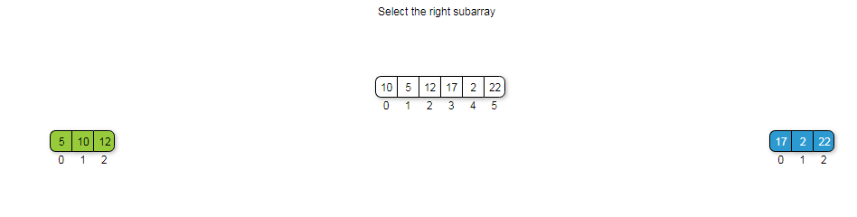
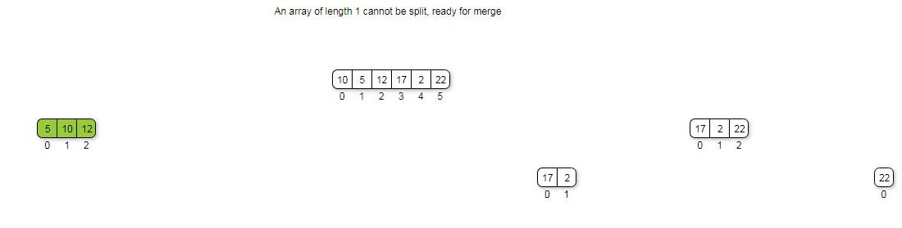
Demo
Unit2

Slide 22
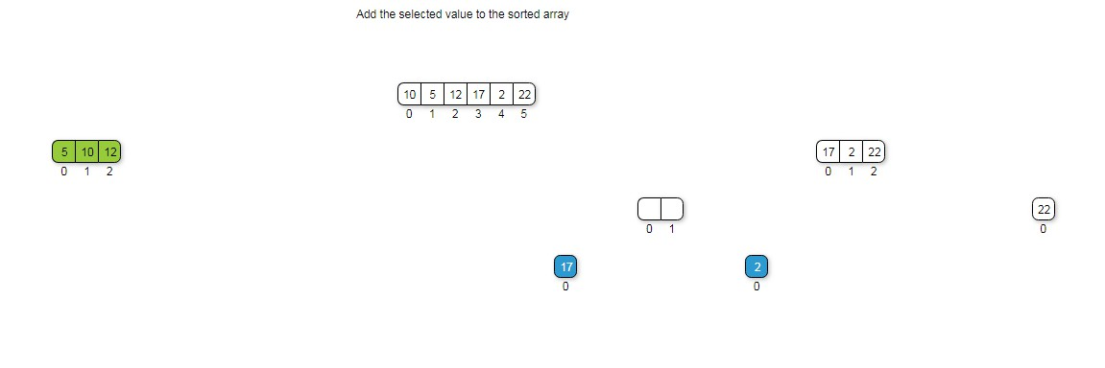
Demo
Unit2

Slide 23
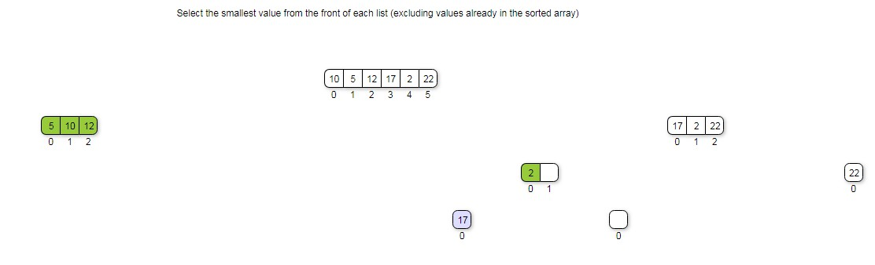
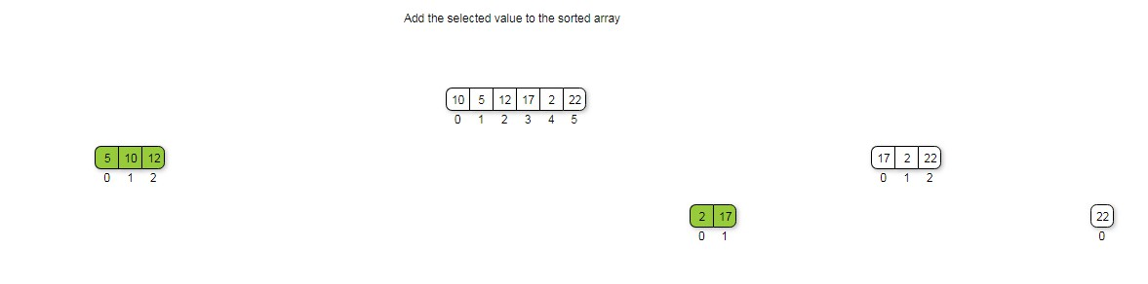
Demo
Unit2

Slide 24
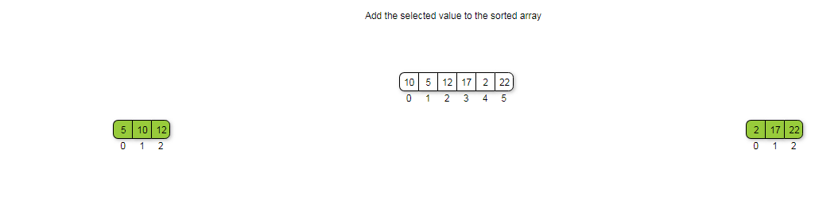
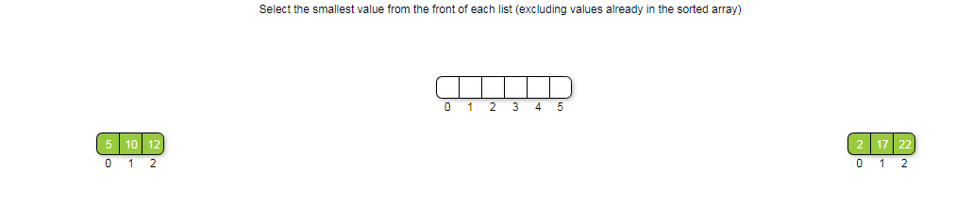
Demo
Unit2

Slide 25
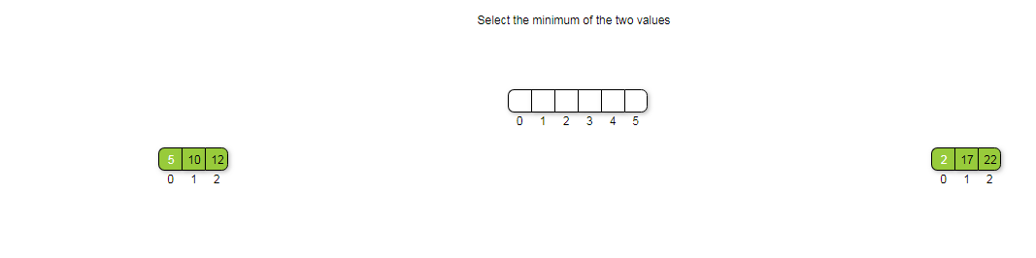
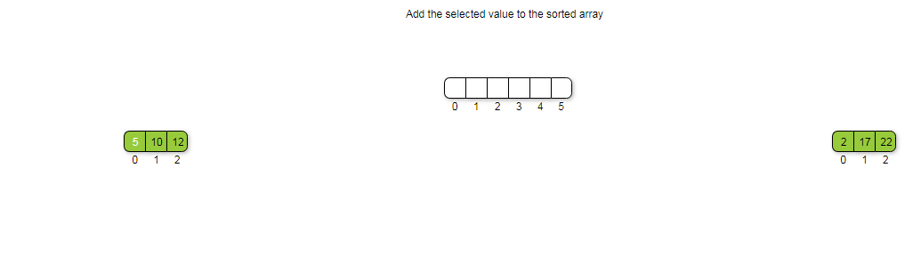
Demo
Unit2

Slide 26
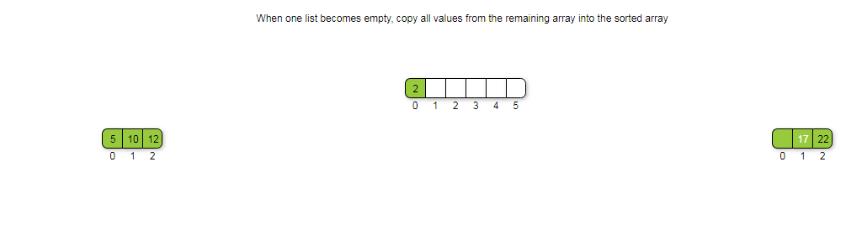
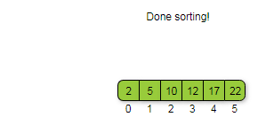
Demo
Unit2

Slide 27
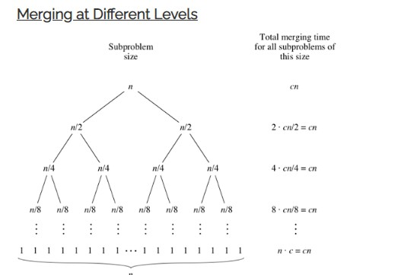
Analysis
Unit2

Slide 28
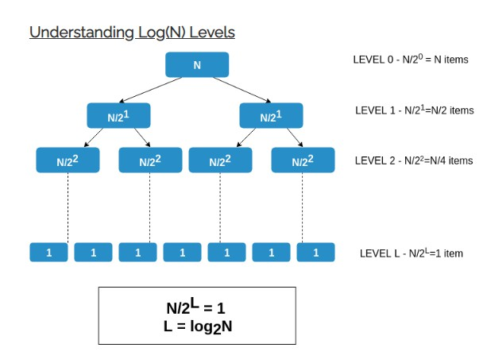
Analysis
Unit2

Slide 29
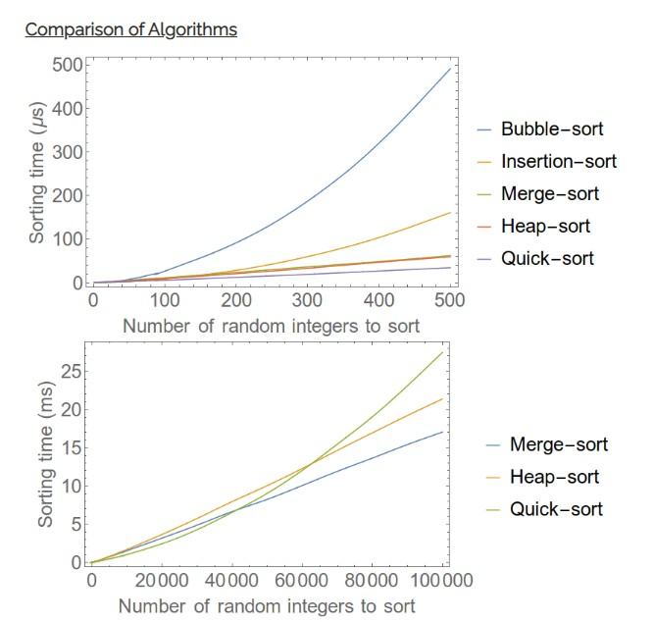
Analysis
Unit2

Slide 30
Analysis
Complexity Analysis of Merge Sort:
Time Complexity:
Best Case: O(n log n), When the array is already sorted or nearly
sorted.
Average Case: O(n log n), When the array is randomly ordered. Worst Case: O(n log n), When the array is sorted in reverse order. Space Complexity: O(n), Additional space is required for the temporary array used during merging.
Unit2

Slide 31
Analysis
Advantages of Merge Sort:
Stability: Merge sort is a stable sorting algorithm, which means it
maintains the relative order of equal elements in the input array. Guaranteed worst-case performance: Merge sort has a worst-case time complexity of O(N logN), which means it performs well even on large datasets.
Simple to implement: The divide-and-conquer approach is
straightforward.
Unit2

Slide 32
Analysis
Disadvantage of Merge Sort:
Space complexity: Merge sort requires additional memory to store
the merged sub-arrays during the sorting process.
Not in-place: Merge sort is not an in-place sorting algorithm, which
means it requires additional memory to store the sorted data. This can be a disadvantage in applications where memory usage is a concern.
Applications of Merge Sort:
Sorting large datasets
External sorting (when the dataset is too large to fit in memory) Inversion counting (counting the number of inversions in an array) Finding the median of an array
Unit2

Slide 33
Test Your Knowledge
1. A list of n string, each of length n, is sorted into lexicographic order using the merge-sort algorithm. The worst case running time of this computation is
O (n*log(n))
O (n² log n)
O (n² + log(n))
O (n²)
Unit2

Slide 34
Test Your Knowledge
In a modified merge sort, the input array is splitted at a position one-third of the length(N) of the array. Which of the following is the tightest upper bound on time complexity of this modified Merge Sort.
N(logN base 3)
N(logN base 2/3)
N(logN base 1/3)
N(logN base 3/2)
Unit2

Slide 35
Test Your Knowledge
3. If one uses straight two-way merge sort algorithm to sort the following elements in ascending order: 20, 47, 15, 8, 9, 4, 40, 30, 12,
17 then the order of these elements after second pass of the
algorithm is:
8, 9, 15, 20, 47, 4, 12, 17, 30, 40
8, 15, 20, 47, 4, 9, 30, 40, 12, 17
15, 20, 47, 4, 8, 9, 12, 30, 40, 17
4, 8, 9, 15, 20, 47, 12, 17, 30, 40
Unit2

Slide 36
Test Your Knowledge
Given two sorted list of size m and n respectively. The number of comparisons needed the worst case by the merge sort algorithm will be
m x n
maximum of m and n
minimum of m and n
m + n - 1
Unit2

Slide 37
Test Your Knowledge
Of the following sorting algorithms, which has a running time that is least dependent on the initial ordering of the input?
Merge Sort
Insertion Sort
Selection Sort
Quick Sort
Unit2

Slide 38
Test Your Knowledge
You have to sort 1 GB of data with only 100 MB of available main memory. Which sorting technique will be most appropriate?
Heap sort
Merge sort
Quick sort
Insertion sort
Unit2

Slide 39
Test Your Knowledge
What is the best sorting algorithm to use for the elements in array are more than 1 million in general?
Merge sort.
Bubble sort.
Quick sort.
Insertion sort.
Unit2

Slide 40
Answers
Questions | Answer
1 | B
2 | D
3 | B
4 | D
5 | A
6 | B
7 | C
Unit2

Slide 41
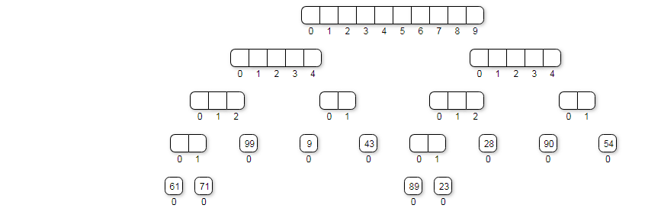
EXCERCISE
Try this
Unit2

Slide 42
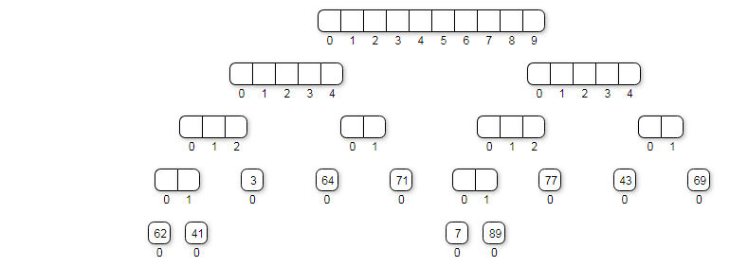
EXCERCISE
Try this
Unit2

Slide 43
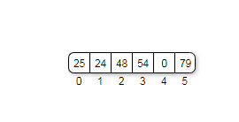
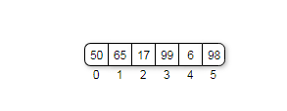
EXCERCISE
Perform merge sort on given data
Perform merge sort on given data
Unit2

Slide 44

REVIEW
Merge sort is a sorting algorithm that uses this approach. In Merge Sort we will:
DIVIDE : Split an array into parts recursively into half.
CONQUER : Sort the sub-arrays individually.
COMBINE : Merge the sorted sub-arrays to get a big sorted array
Unit2

Slide 45

THANK YOU

